Slide 1

Space, Range & Display- Store Clustering
Somnath Bardhan
December 2006
Notes:
1

Slide 2
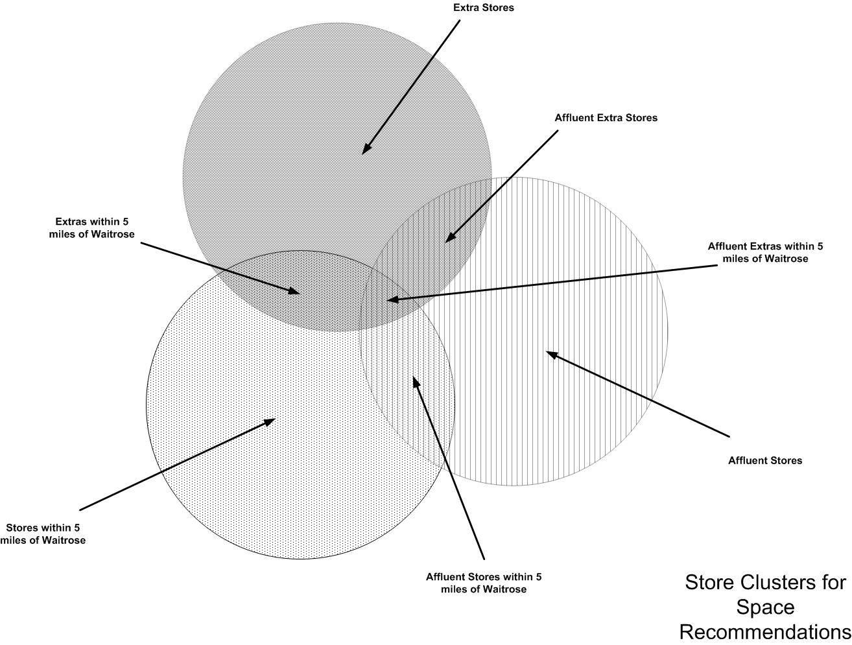
What is Store Clustering
Store Clustering is a logical way of grouping certain number of stores which share certain characteristics leading to their performance in a similar way
An example of a Store Cluster

Slide 3
Familiarization with the terms
Attribute: An attribute is a variable used to define the characteristics of a particular cluster. Eg. Country, format and Affluence. We can add as many number of attribute types as decided by the Store marketing group.
Value: Value defines the various attribute types. Eg. Country like England, UK, Scotland etc. Format such as extra, metro, superstore, express etc. and Affluence like up-market and mid market etc.
Cluster: A cluster is a logical association of a group o stores that share certain Characteristics leading to their performing in similar ways (in terms of their Sales, Profit, Level Rundown or other Key Performance Indicator, KPI)
Exception: Exceptions are the mechanism used to override a store’s attribute value with a value that can be used for ranging. Exceptions are associated at the Display group level.
Overlay: Overlays are the mechanism used to replace part of a range of products with another range of products more suitable for the store. Overlays appear in store-specific Planograms and not master Planograms. The victim product is the one that is replaced with the Overlay product.

Slide 4
Triggers for Store Clustering
Scheduled Ranging Event: This is done based on a ranging event which is created on a separate application called schedule. For eg. Creation of a new display group which involves creation of new clusters for that display group.
Business expansion work: This occurs when the natural works team decides for the need for opening a new store, for an extension or for a refit to an existing store
Exceptional circumstances: This occurs when the store marketing group decides on creating a new attribute structure or a new format.

Slide 5
Various Activities in Store Clustering
Create attribute type and values: The main task under the same would be Add new attributes, add and delete the attribute type values, select which attributes are to be used for ranging purposes ie. During the clustering of the stores.
Link attribute to the stores: This task allows the user to select attribute values that define each store. Each store must have one value, and only one value, for each attribute type. Generally a store’s attribute values will be defined once – either at the setup of the Store Clustering application, or when a new store is built. Very occasionally a store will change its attribute definition e.g. when an extension has been built.
Define ranging attributes per display group: This task allows the user to select the attribute types that are important for ranging purposes for each merchandising group. This can be done at the merchandising group department level (e.g. B – Bakery), the merchandising group section level (e.g. B1 – Pre-packed bakery) or the merchandising group level (e.g. B1B pre-packed bread)

Slide 6
Various Activities in Store Clustering
Define Cluster per Display Group: This task allows the user to create sets of stores that will be ranged together for an event and for a specified Display group. For example, for ranging the bakery merchandising department, Upmarket Superstores and Extras will be clustered together.
Define Exceptions per Store/display group: This task allows the user to define exceptions per store/display group by which we mean that we override a ranging attribute value with a value more suitable for the ranging event.
Add Overlays to store/Display group: This task is used to define a set of products which can replace a range of products which are more suitable for the store. Overlays are defined for victim products which are the ones going to be replaced. The Overlay product details are maintained only in Store specific Planograms and not the master Planogram.

Slide 7
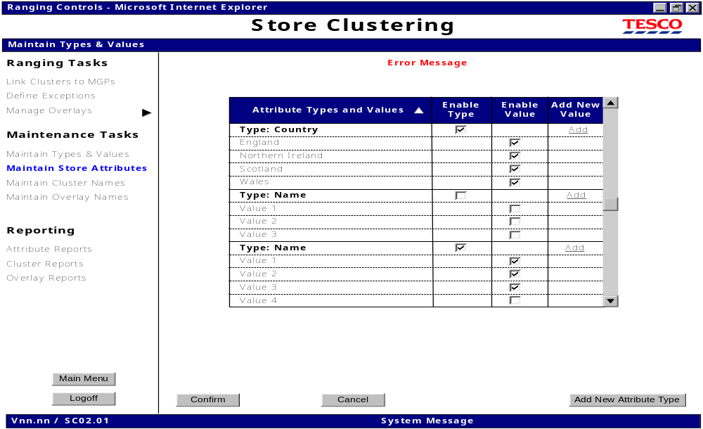
Screen Shots
This screen is used for maintaining new Attributes and values

Slide 8
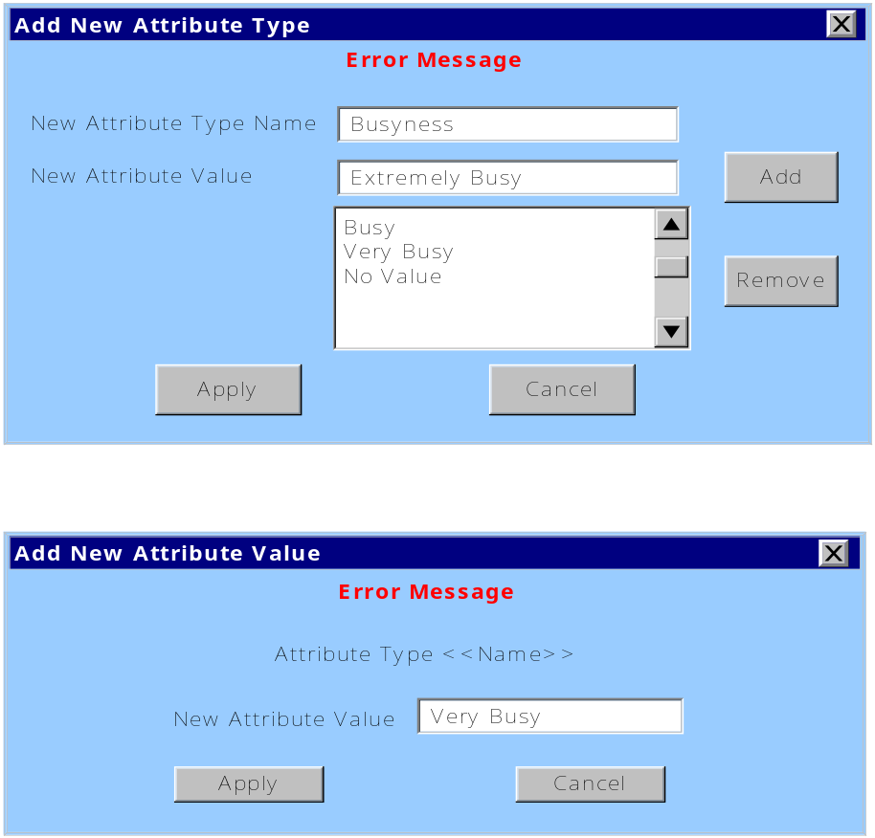
Screen Shots
This screen is used for adding new Attributes and values

Slide 9
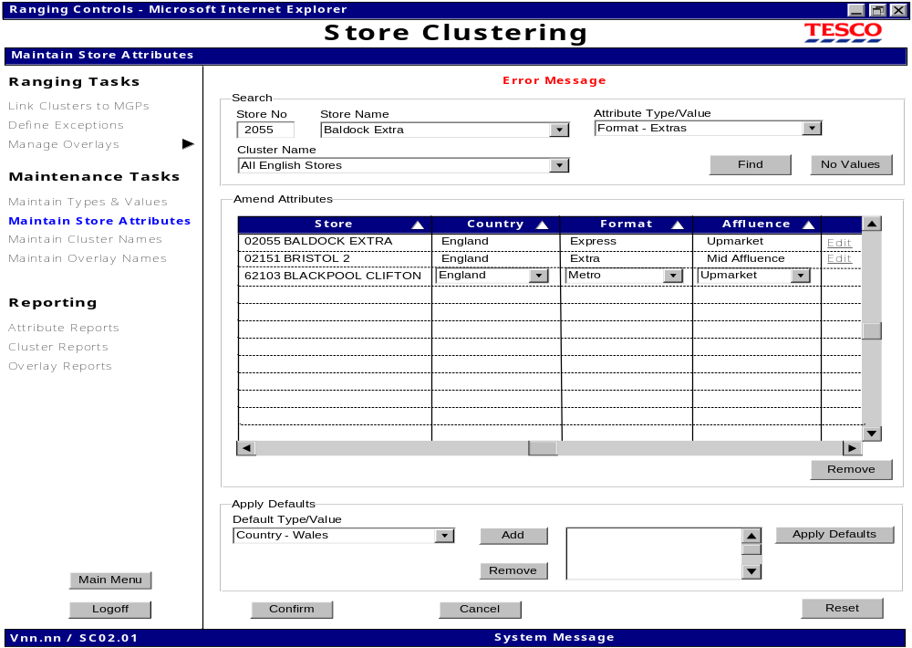
Screen Shots
This screen is used for amending values for store based on search

Slide 10
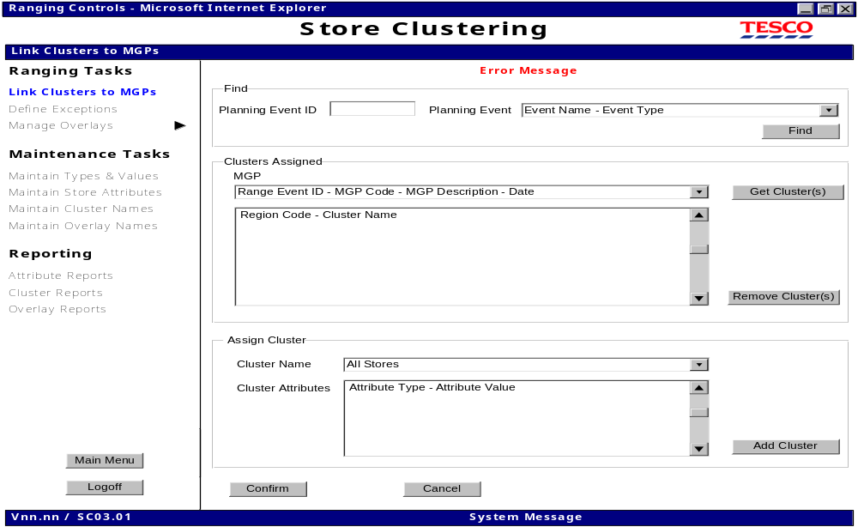
Screen Shots
This screen is used for assigning Clusters to Display Group

Slide 11
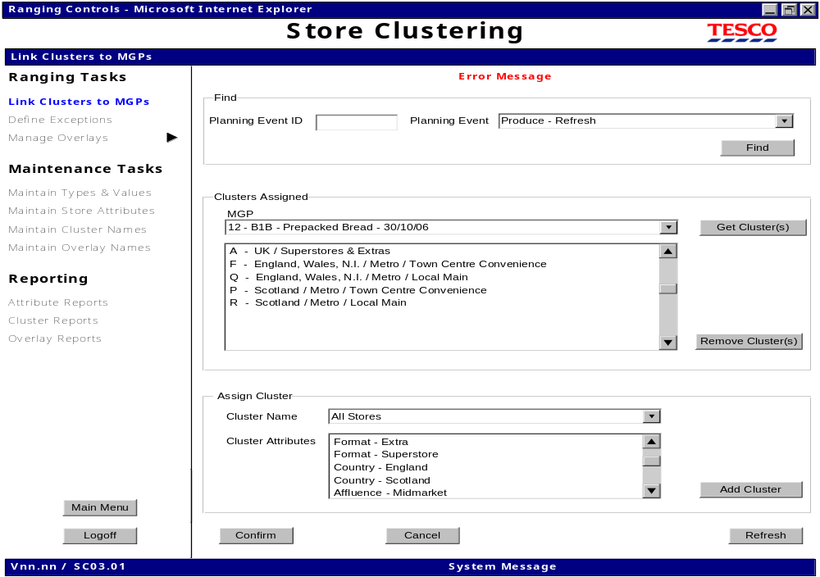
Screen Shots
This screen is used for adding new clusters to Display group

Slide 12
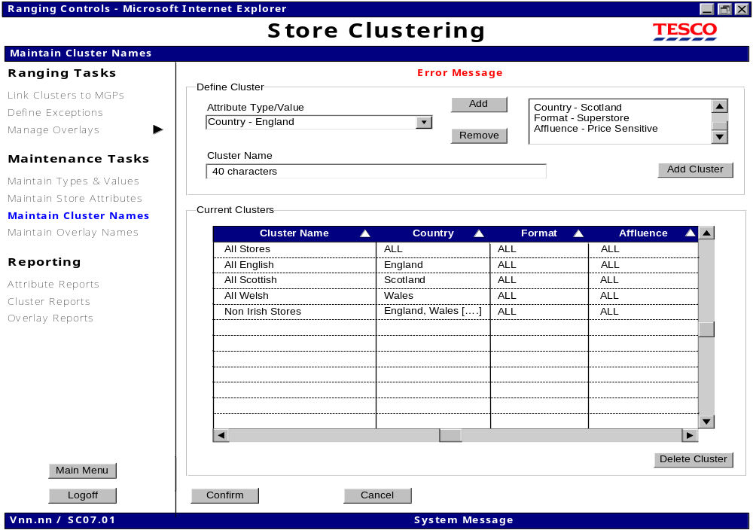
Screen Shots
This screen is used for add/delete of Clusters

Slide 13
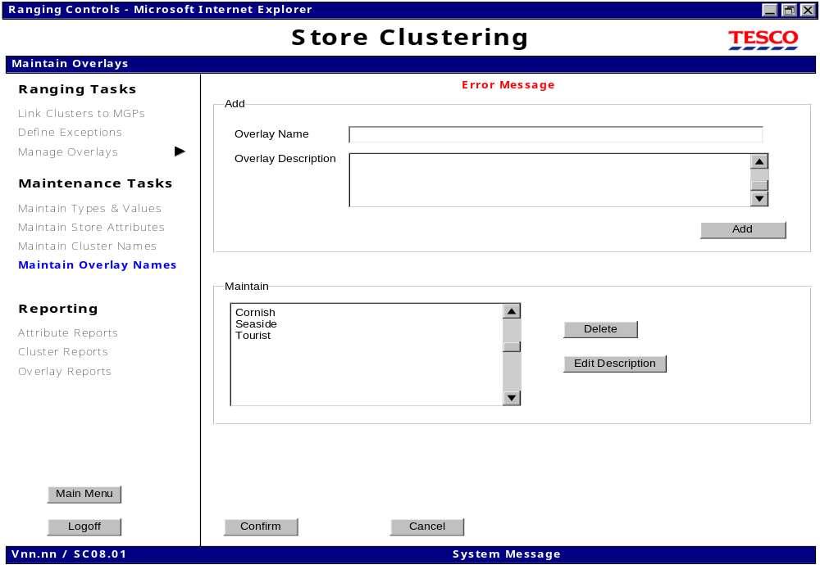
Screen Shots
This screen is used for adding and modifying Overlays to the existing set

Slide 14
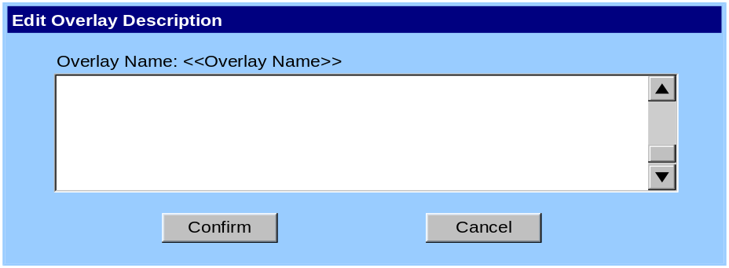
Screen Shots
This screen is used for editing the description of an existing Overlay

Slide 15
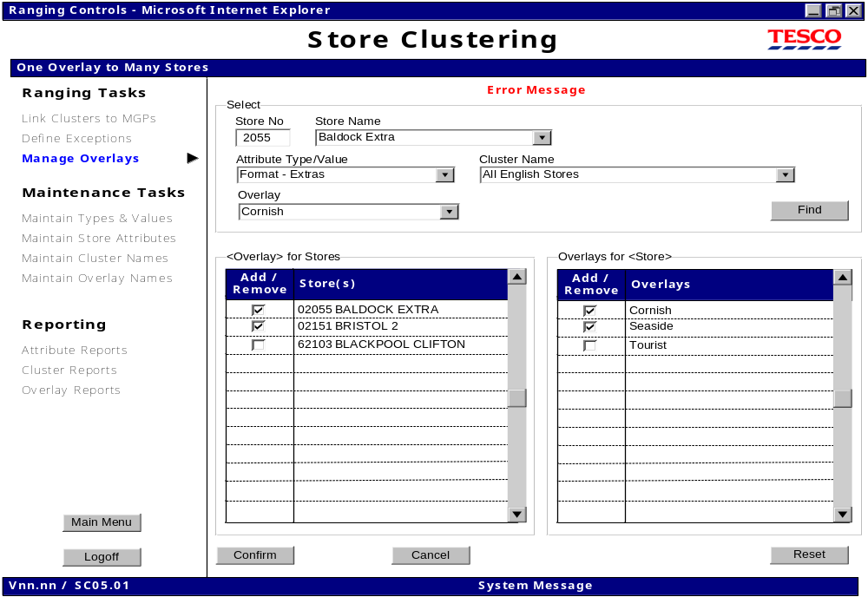
Screen Shots
This screen is used for managing the Overlays

Slide 16
Summary
What is Store Clustering
What are the various triggers for store Clustering
What are the various activities in Store Clustering
Screen level Overview of the functionality

Slide 17
Questions

